Slide 1
Error Handling & ref, out, and goto Keywords

Slide 2
Error handling
People don’t follow instructions
People press the wrong keys
People push the limits
In a professional product, it is your responsibility to make sure invalid inputs don’t crash your program… Or worse…
SQL injections
Invalid, unverified transactions

Slide 3
Simple demo, handling bad input
Console application with a simple menu that accepts integer input.
Try { } catch { }
int.TryParse vs int.Parse
out keyword
Passing value types by reference
ref keyword
Skipping around our code
goto keyword

Slide 4
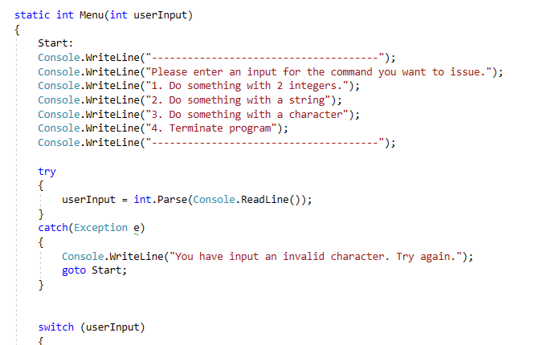

Slide 5
out & ref
out
Indicates that this parameter will be set, or created inside of the method.
The argument MUST be set before the method is done.
Demo
ref
Allows you to send value types as reference types so you can directly modify them.
Some cases you want to modify the actual reference, not the object pointed to.
Demo

Slide 6
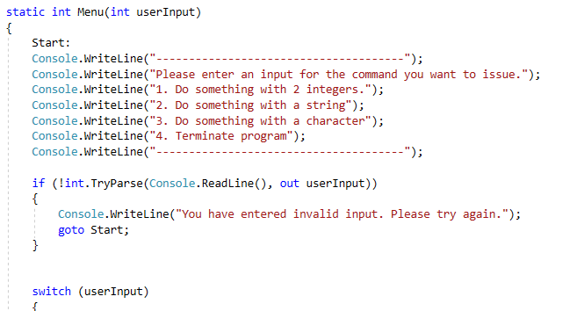
Out
Out allows you to return multiple values as well. In the example below the function returns a Boolean, but it also sets the value of userInput

Slide 7
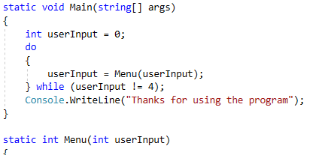
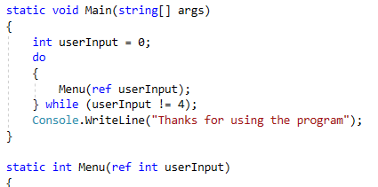
Ref
Ref forces value types to be sent by reference as opposed to by value. Allows interactions like what is seen below.

Slide 8
goto
With the goto statement you can traverse your code using labels and cases.
Useful in combination with error handling to go back to a previous line and retry.
Useful for skipping some code that you don’t need to run.

